Slide 1
HW4 - Hypothesis Testing
Akshaj Kammari

Slide 2
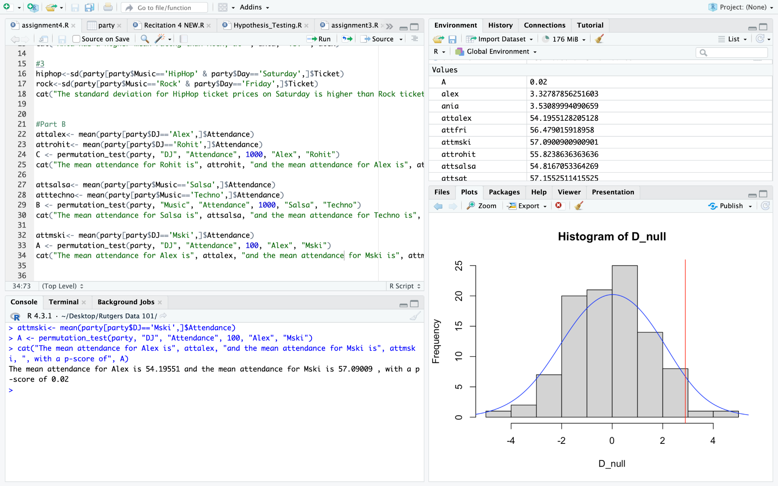
A
Null Hypothesis: Alex has a higher mean attendance than Mski
Alternative Hypothesis: Mski has had higher attendance than Alex
for A, p-value is small (but not zero!). The smallest I could get the p-value to be is shown, showing greater confidence in rejecting the null hypothesis

Slide 3
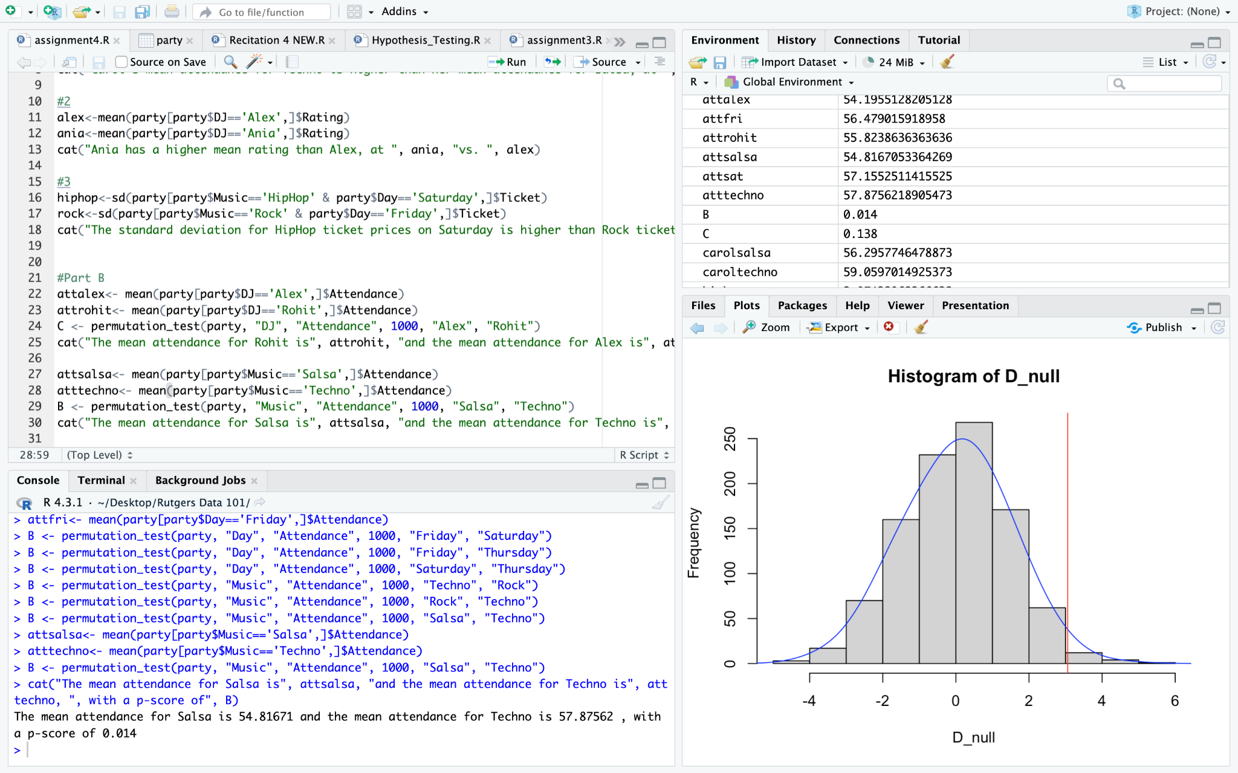
B
Null Hypothesis: Techno has a higher mean attendance than Salsa
Alternative Hypothesis: Salsa has had higher attendance than Techno
For B, p-value is close to (but smaller) than critical value, say 0.03, at a value of ~ 0.014

Slide 4
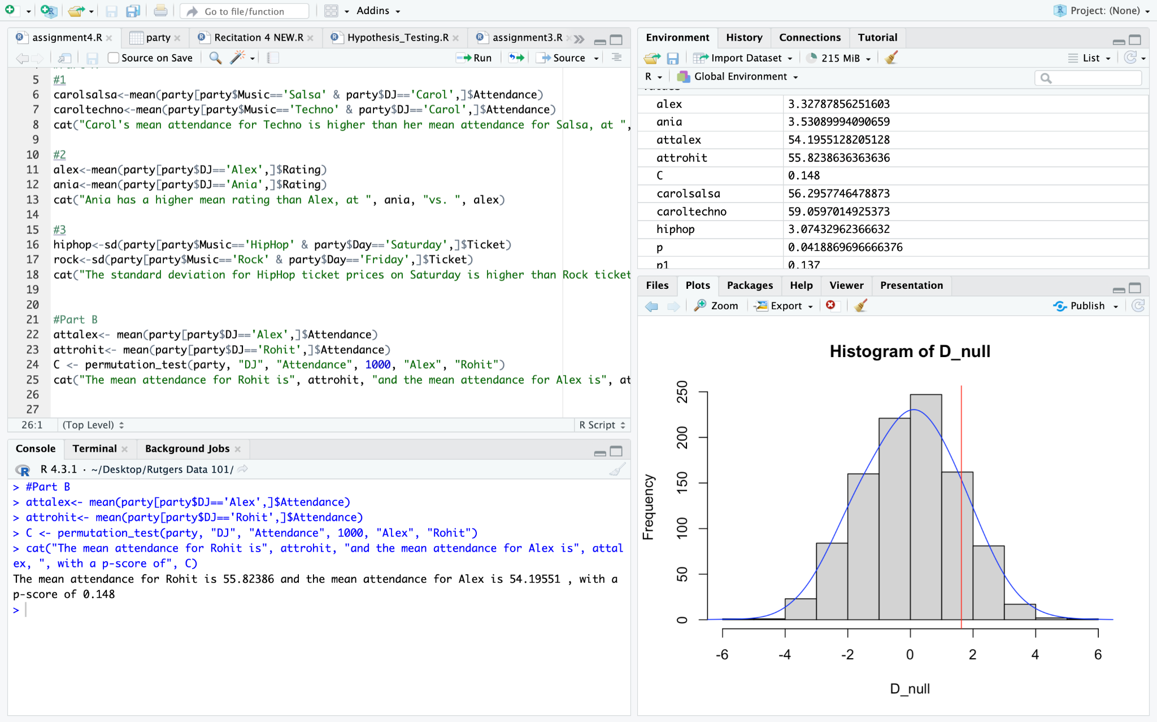
C
Null Hypothesis: Rohit has a higher mean attendance than Alex
Alternative Hypothesis: Alex has had higher attendance than Rohit
For C, p-value is larger than critical value of 0.05, in this case it is ~ 0.148. We can conclude that I would fail to reject the null hypothesis.

